Slide 1
MRM and MORRIS COUNTY ENVIRONMENTAL COORDINATORS MEETING

Slide 2
Electronics Recycling Program Update

Slide 3
MRM Morris County Program

Slide 4
MRM Morris County Program

Slide 5
MRM Morris County Program

Slide 6
NJ DEP Reporting

Slide 7
Reporting Forms

Slide 8
Current Program Status

Slide 9
Goal: Program Improvements

Slide 10
Continuous Improvement Recommendations

Slide 11
Improved Pick Ups

Slide 12
Other Improvement Actions

Slide 13
Sorting: Large Televisions Back To Back On Pallets

Slide 14
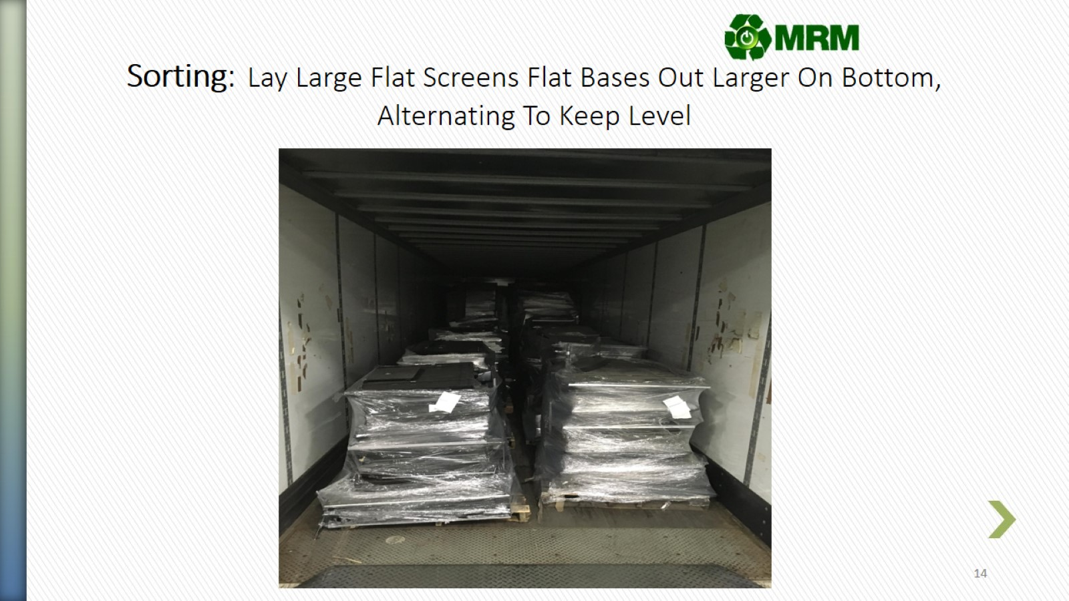
Sorting: Lay Large Flat Screens Flat Bases Out Larger On Bottom, Alternating To Keep Level

Slide 15
Sorting: Small TVs, Monitors, Flat Screens

Slide 16
Gaylord Items

Slide 17
Signs

Slide 18
Increasing Weight Per Pick Up

Slide 19
QUESTIONS?

